Slide 1
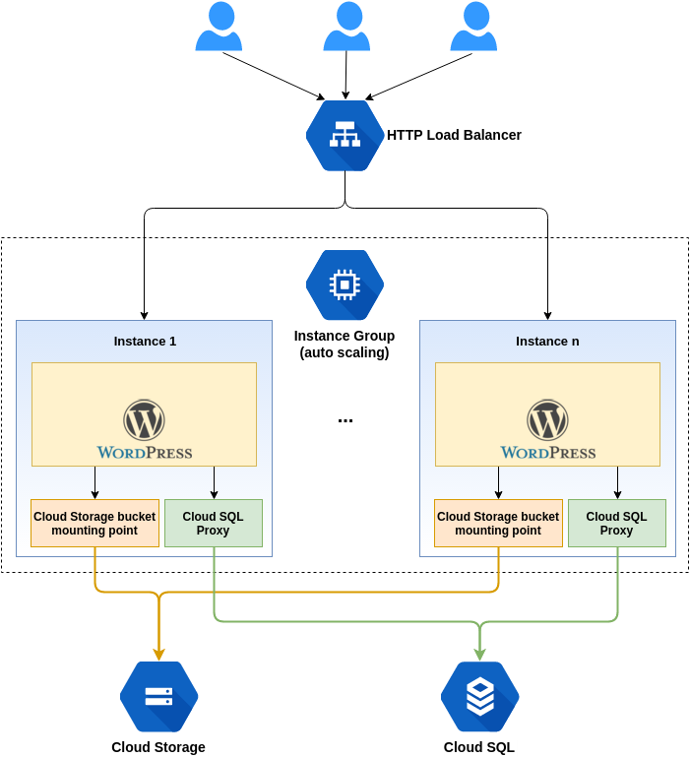
Architecture Diagram
NLP Text
AI Model:
code-davinci-edit-001
Terraform Code
Jenkins Pipeline
1. Generate Text Based Prompt
2. Analysed by AI Model
Instance 1
Instance n
3. Generate Terraform Code
4. Validation & Deployment
Architecture Diagram
NLP Text
AI Model:
code-davinci-edit-001
Terraform Code
Jenkins Pipeline

Slide 2
NLP Text
AI Model:
code-davinci-edit-001
Terraform Code
Jenkins Pipeline
2. Analysed by AI Model
1. Generate Text Based Prompt
3. Generate Terraform Code
Instance 1
Instance n
4. Validation & Deployment
NLP Text
AI Model:
code-davinci-edit-001
Terraform Code
Jenkins Pipeline

